Slide 1
Resilient and Scalable Web Application Deployment on AWS
Name : Ashish Gajanan Ingle
Date:21-05-2025

Slide 2
Agenda
● Introduction to the Project
● Objectives
● Importance of scalability and Resilience in web application
● Project Deployment
● Project Phases
● Screenshots
● Lessons Learned and best practices
● Conclusion
● Questions and Answers
● References
● Thankyou page

Slide 3
Introduction
This project involves designing and implementing a highly available and scalable web application infrastructure on AWS.
This project aims to design and implement a highly available and scalable infrastructure for a web application on AWS. The architecture will leverage AWS services to ensure the web application can efficiently handle varying loads and maintain high availability across multiple Availability Zones.

Slide 4
Objectives
High Availability: Achieve minimal downtime by utilising multiple Availability Zones.
Scalability: Use AWS Auto Scaling to adjust resources automatically in response to traffic changes.
Security: Implement security measures focusing on security groups and secure communication.
Resilience: Develop an application setup that can withstand failures and traffic spikes without manual intervention.

Slide 5
Importance of Resilience and Scalability in web application
SCALABILITY
Adapts to growing user traffic without performance degradation.
Optimizes resource utilization, ensuring cost-effective operations.
Maintains responsiveness, delivering a seamless user experience even under
heavy loads.
RESILIENCE
Handles unexpected failures gracefully, such as server crashes or network outages.
Ensures high availability, minimizing downtime and maintaining user access.
Protects data integrity, preventing loss or corruption during failures.

Slide 6
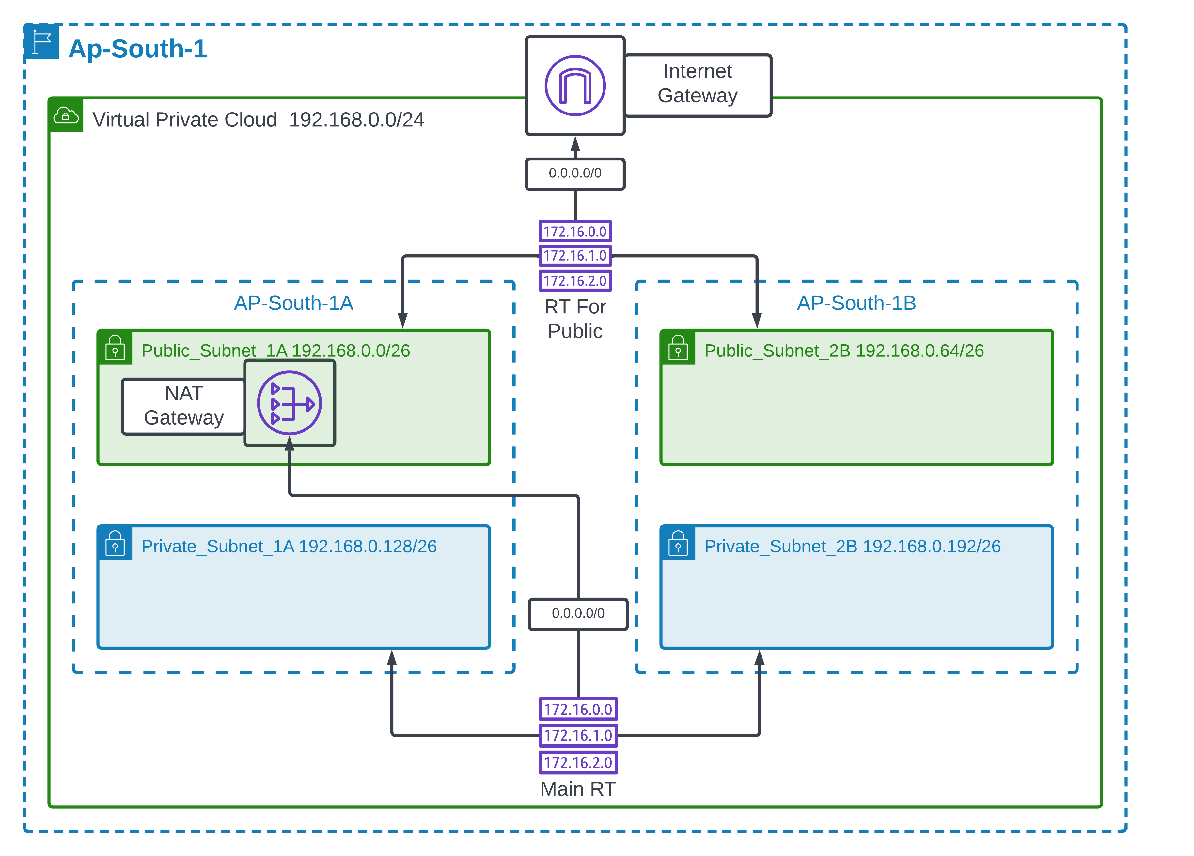
Project Deployment

Slide 7
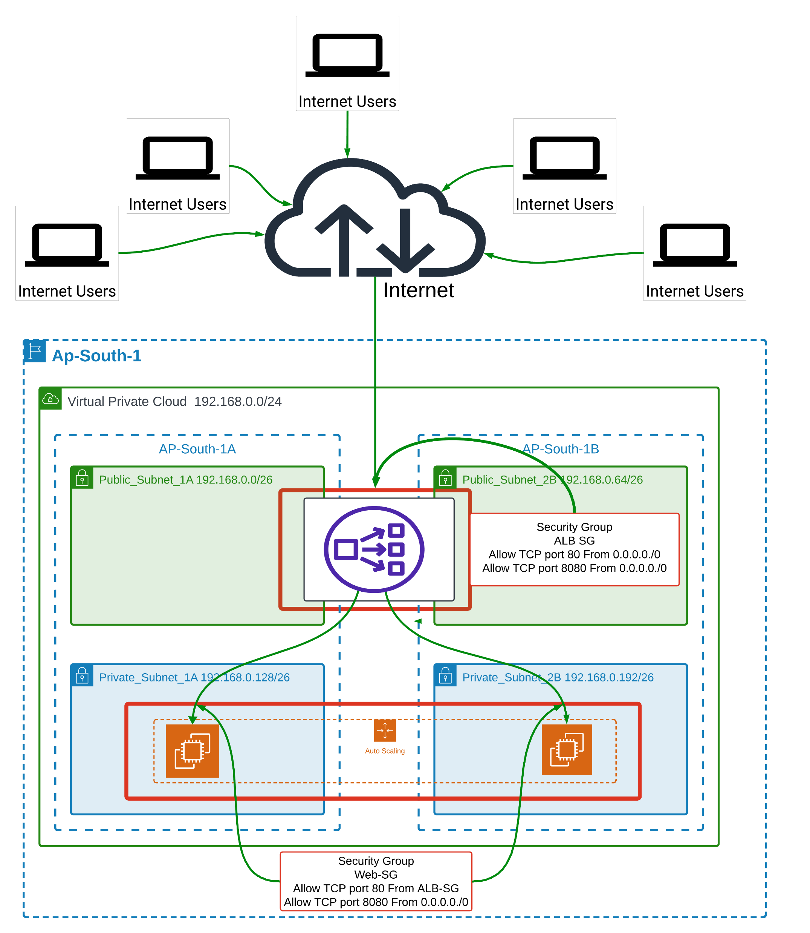

Slide 8
High-Level Design
● Diagram: Include a cloud architecture diagram showing the relationship between VPC, EFS, EC2 instances, Auto Scaling, ALB, and Route 53.
● VPC Configuration: Detail the setup of the VPC, including subnets across multiple Availability Zones for high availability.
● Security: Describe the security groups, IAM roles, and policies to ensure secure access and communication.
Core AWS Services Utilization:

Slide 9
1 Virtual Private Cloud (VPC) Set up a custom VPC to provide a isolated network environment. This VPC will have public and private subnets across different AZs for enhanced security and availability.
2 Elastic File System (EFS) Leverage EFS for scalable file storage, which can be concurrently accessed by instances for storing shared application data.
3 Elastic Compute Cloud (EC2):Utilize EC2 instances to host the web application.These instances will serve as the compute resources running the application, benefiting from AWS's secure, resizable compute capacity.
4 AWS Auto Scaling Configure Auto Scaling to dynamically adjust the number of EC2 instances, ensuring that the application scales efficiently with demand.pic
5 Application Load Balancer (ALB) Utilize an ALB to distribute incoming traffic across multiple EC2 instances in different AZs, enhancing the fault tolerance and availability of the application.
6 Route 53 Employ Route 53 for domain management and to route end-user requests to the application in a reliable and cost-effective manner.

Slide 10
Project Phases:
1 Design Phase: Architect the solution, focusing on the applications, Security, Scalability, Availability requirements
2 Implementation Phase: Create the VPC, subnets, and security groups, Configure EFS, Setup Custom AMI For Auto Scaling, Set up and test Auto Scaling, Deploy the ALB, Integrate Route 53 for domain management
3 Testing and Optimization Phase Conduct functional and load testing to ensure the application's performance and scalability meet requirements.
4 Documentation Phase Produce detailed documentation covering the architecture, configuration, and deployment process.

Slide 11
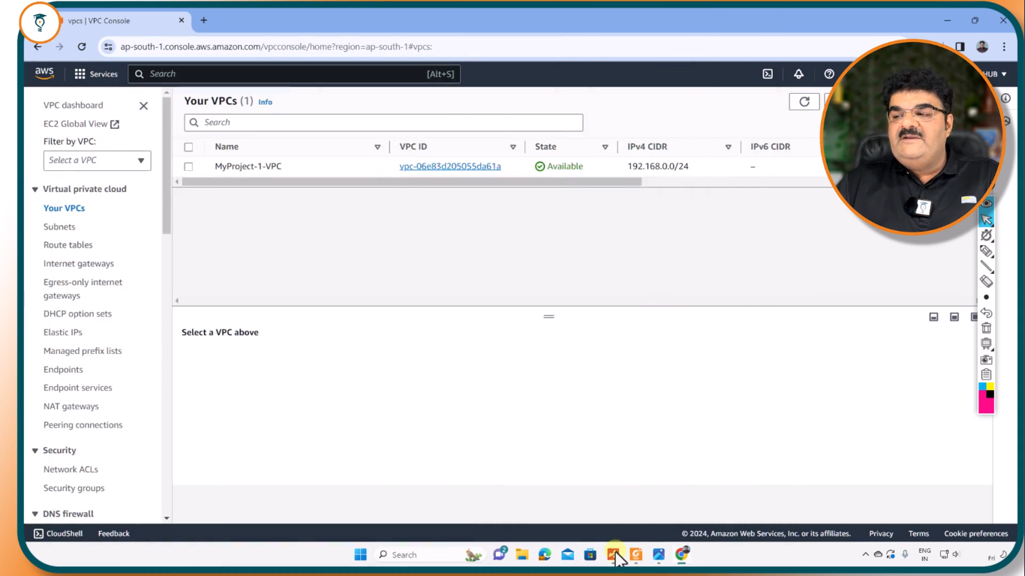
screenshots

Slide 12
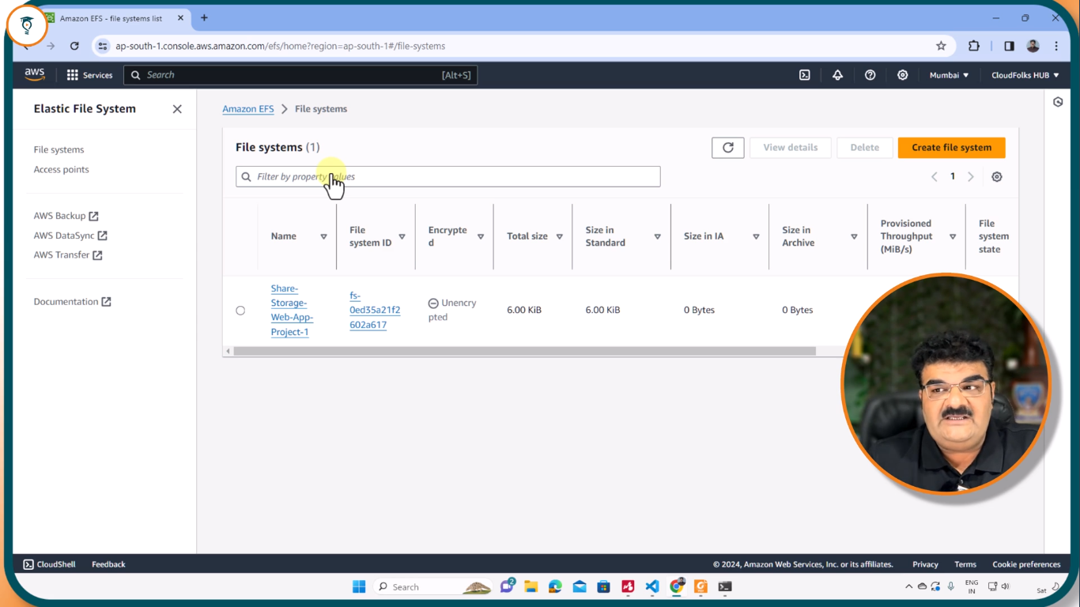
EFS(ELASTIC FILE SYSTEM)

Slide 13
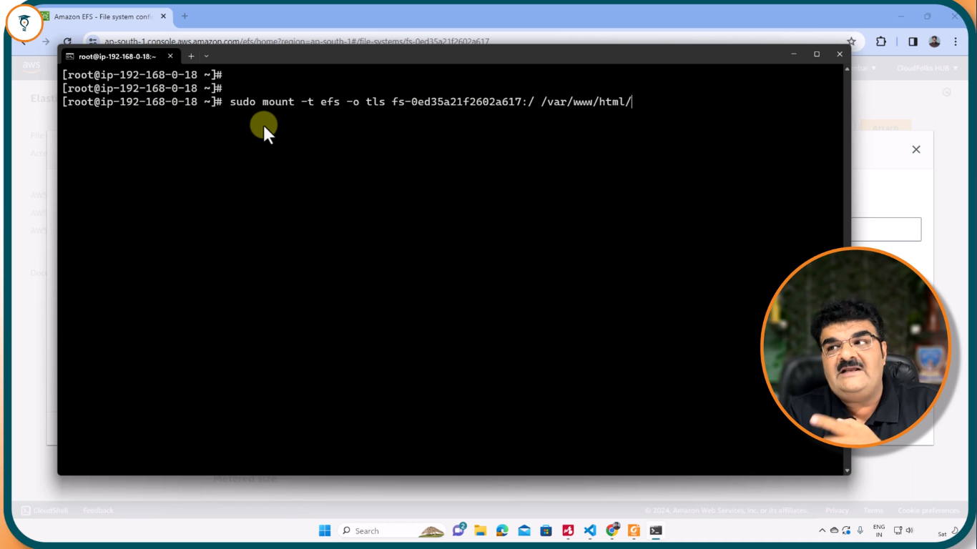
MOUNT EFS FILE

Slide 14
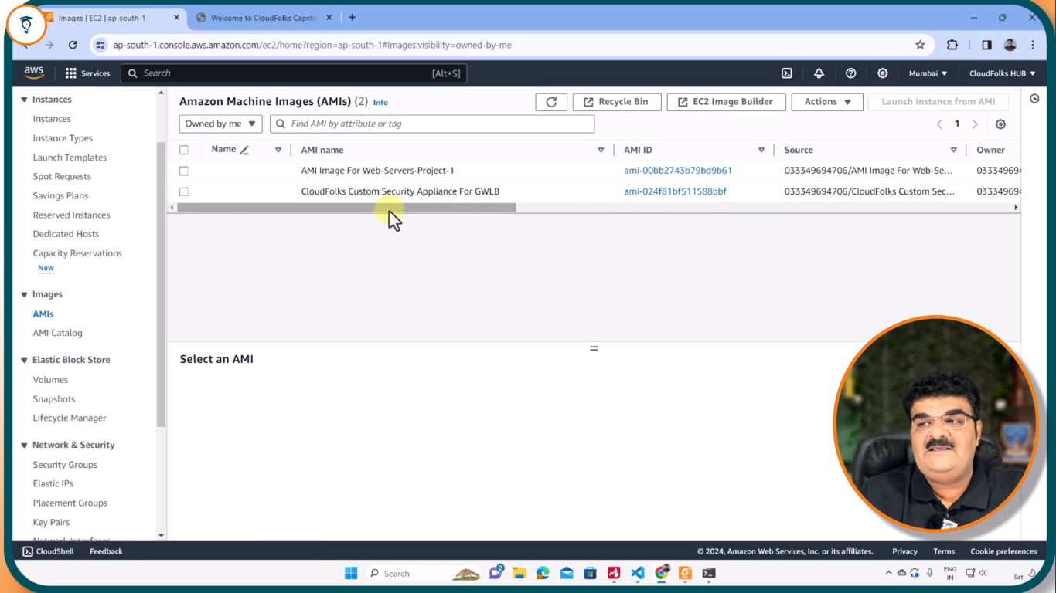
AMI FOR WEB SERVER

Slide 15
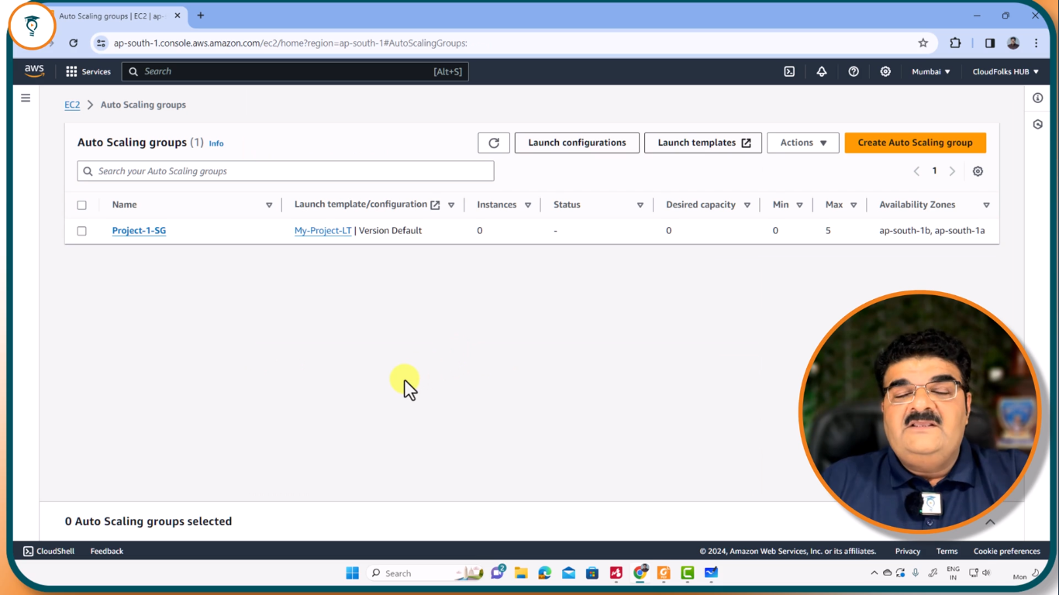
AUTO-SCALING GROUP

Slide 16
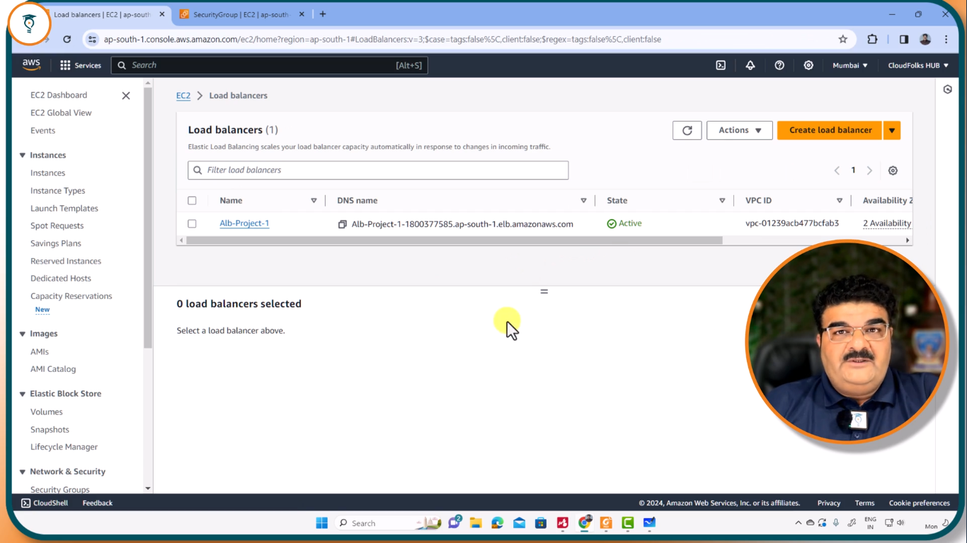
LOAD BALANCER

Slide 17
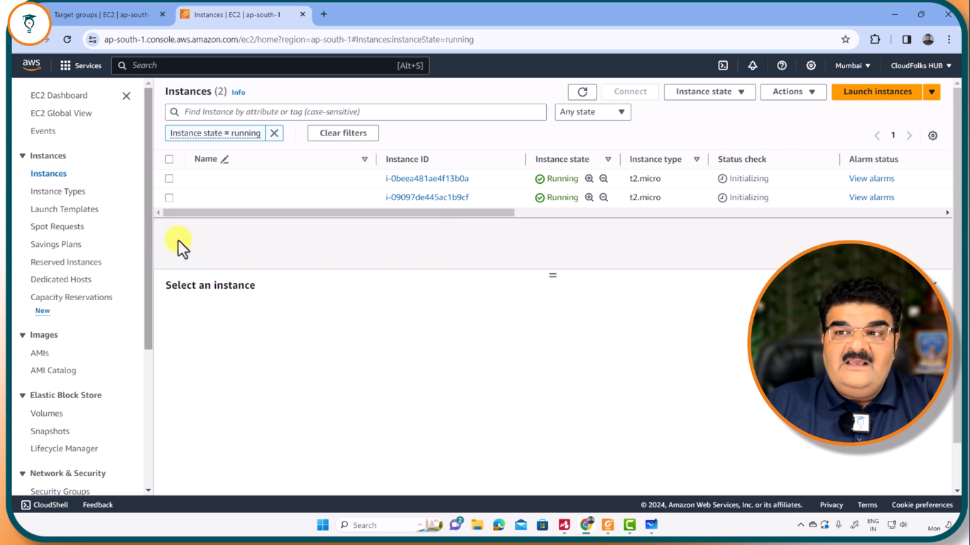
INSTANCES

Slide 18
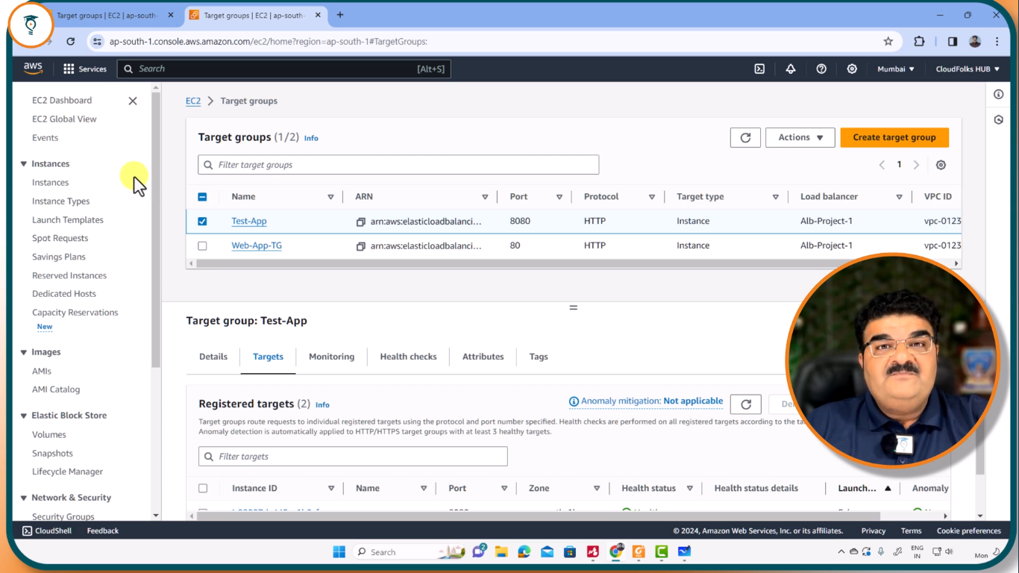
TARGET GROUPS

Slide 19
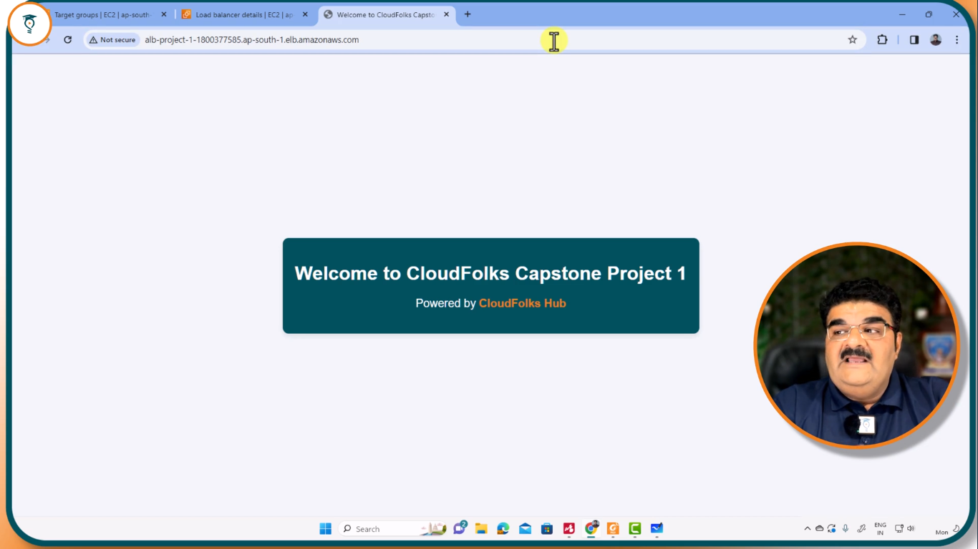
OPENING WEBSITE FROM LOAD BALANCER URL

Slide 20
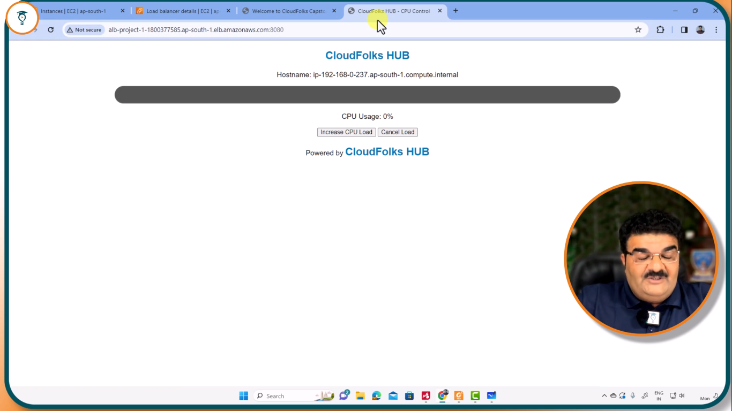
OPENING CPU CONTROL

Slide 21
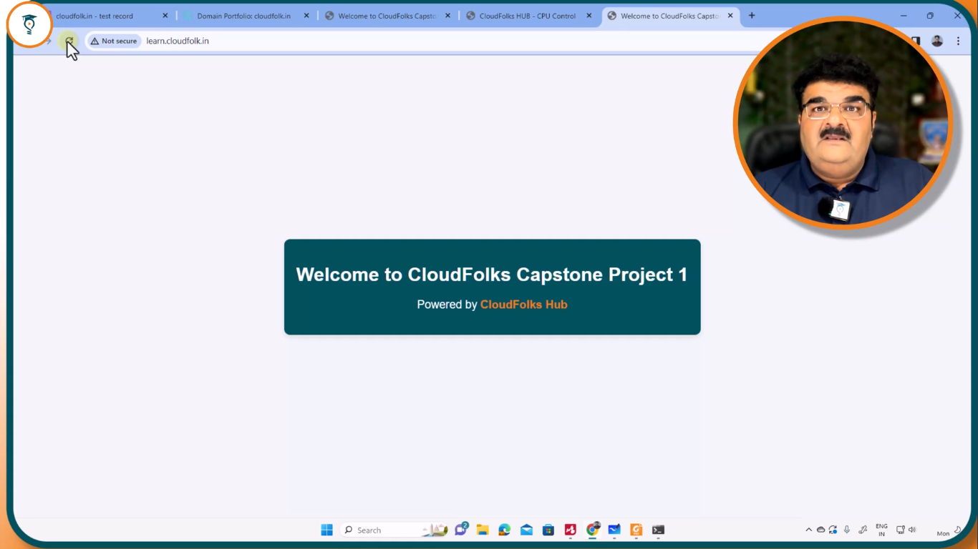
OPENING WEBSITE FROM DNS NAME

Slide 22
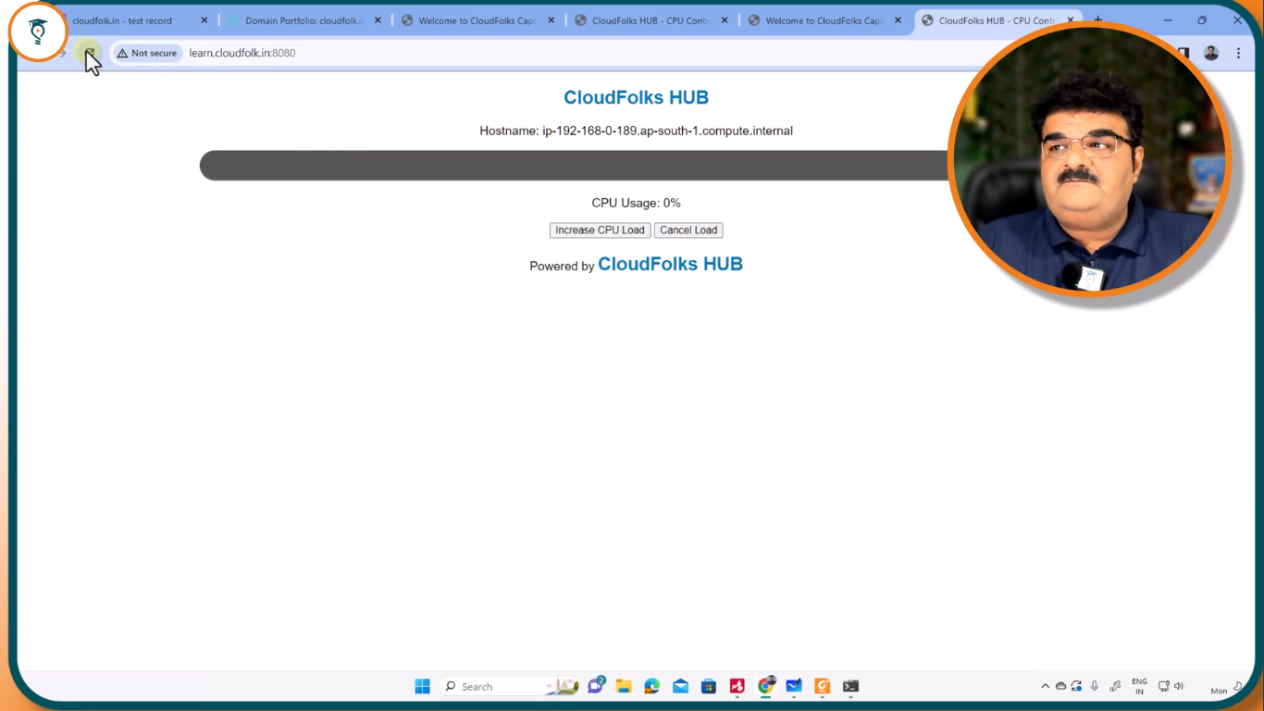
OPENING FROM CLOUDFOLKS.IN/8080

Slide 23
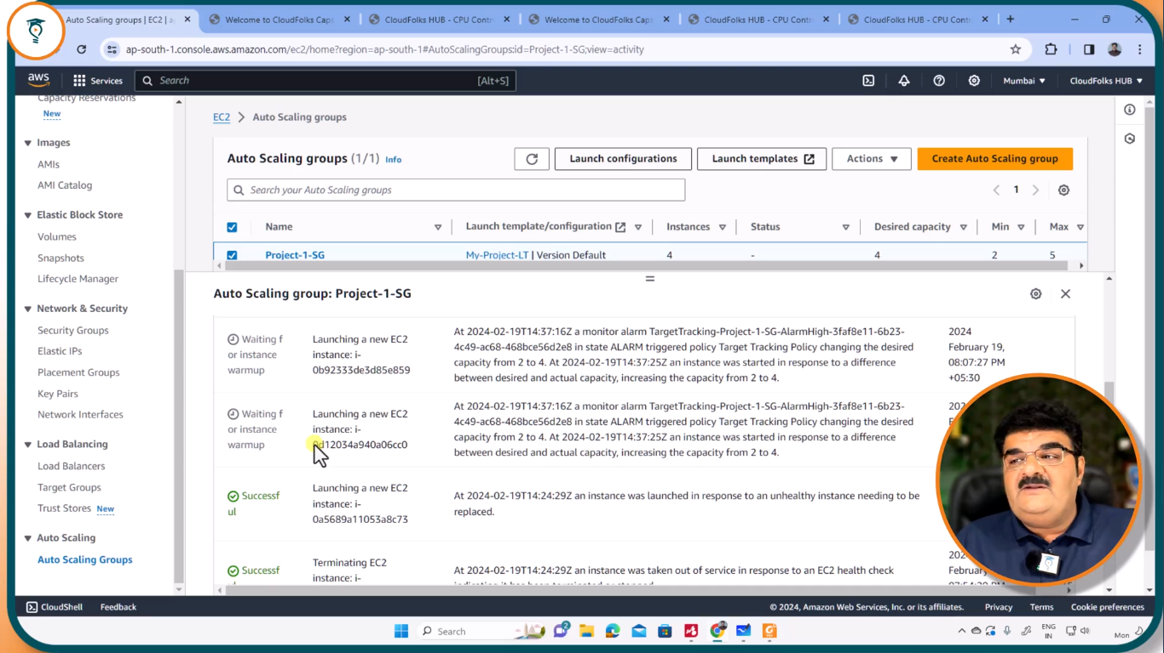
AUTO-SCALING LOGS AND ACTIVITY

Slide 24
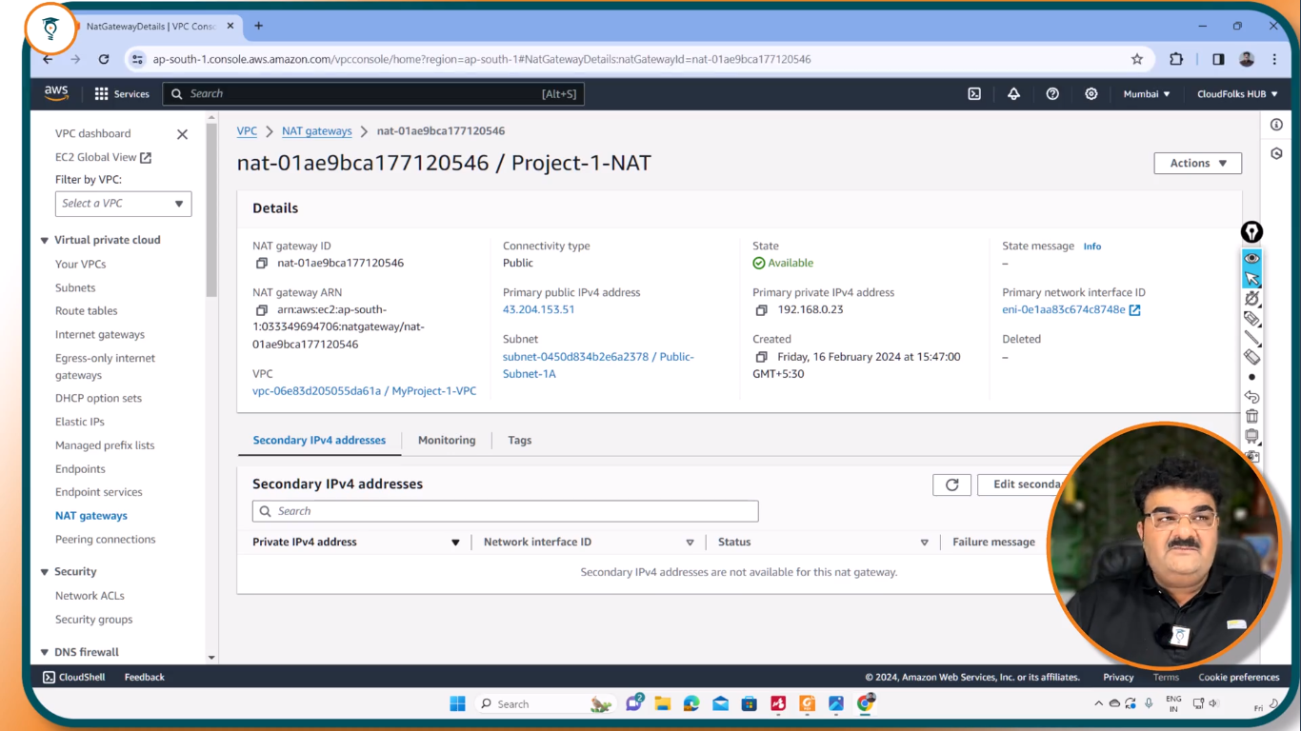
NAT GATEWAY

Slide 25
Lesson learned and best practices
1.Architecture Design
Use AWS Well-Architected Framework to guide your deployment.
Utilize Amazon EC2, AWS Lambda, or ECS based on your application needs.
Implement microservices or serverless architecture for scalability.
2. Security Best Practices
Enable AWS Identity and Access Management (IAM) for role-based access control.
Use AWS Web Application Firewall (WAF) to protect against common threats.
Encrypt sensitive data using AWS Key Management Service (KMS).

Slide 26
3. Performance Optimization
Implement Amazon CloudFront for content delivery and caching.
Use Auto Scaling Groups to handle traffic spikes efficiently.
Optimize database performance with Amazon RDS or DynamoDB.
4. Monitoring & Logging
Enable Amazon CloudWatch for real-time monitoring.
Use AWS X-Ray for debugging and tracing application requests.
Store logs securely with Amazon S3 or AWS CloudTrail.
5. Deployment Strategies
Use AWS CodeDeploy for automated deployments.
Implement Blue-Green Deployment to minimize downtime.
Utilize Infrastructure as Code (IaC) with AWS CloudFormation or Terraform.

Slide 27
Conclusion
This document outlines the initial design for deploying a resilient and scalable web application on AWS. It emphasises high availability, scalability, security, and resilience, leveraging AWS services to achieve these objectives. The next steps include detailed planning, implementation, testing, and deployment phases, ensuring the web application meets the outlined objectives. Continuous monitoring and optimization are vital components of a successful web application deployment on AWS. They ensure that applications remain resilient, scalable, and cost-effective while maintaining high performance and security. By implementing these strategies, organizations achieve: ✅ Enhanced availability with proactive failure detection ✅ Improved security by identifying vulnerabilities early ✅ Better cost efficiency through resource utilization optimization ✅ Seamless scalability as demand grows over time

Slide 28
Questions and Answer
Q1: What makes a web application resilient on AWS?
: A resilient application handles failures gracefully and maintains availability using strategies like Multi-AZ deployment, Auto Scaling, and disaster recovery.
Q2: What key AWS services help achieve scalability?
: Elastic Load Balancing (ELB), Auto Scaling, Amazon RDS Read Replicas, and Amazon CloudFront enable smooth scalability based on traffic demand.
Q3: How does AWS Auto Scaling improve resilience and scalability?
: Auto Scaling automatically adjusts compute resources to handle varying loads, ensuring optimal performance while preventing overutilization.
Q4: What security measures should be implemented?
: Use AWS WAF, IAM policies, security groups, AWS Shield, and regular security audits to protect the application from threats.

Slide 29
Q5: Why is continuous monitoring important in deployment?
: It helps detect issues in real time, optimize performance, and improve security using tools like AWS CloudWatch, AWS X-Ray, and AWS Security Hub.
Q6: What deployment strategy minimizes downtime?
: Blue-Green Deployment ensures seamless updates by maintaining two environments—one live and one in testing—before switching.
Q7: How can cost optimization be achieved on AWS?
: Leverage AWS Cost Explorer, Reserved Instances, Spot Instances, and Compute Optimizer to reduce costs while maintaining efficiency.

Slide 30
References
https://www.cloudfolkshub.com/t/u/activeCourses
AWSTrainingLive – Twitch
Welcome to AWS Documentation
AWS Educate - Cloud Skills for Education- AWSAWS Educate - Cloud Skills for Education- AWS

Slide 31
Thank you
Contact no.:9322476735
Email :ingle13agi@gmail.com

